Slide 1
Patient Matching on FHIR
Grahame Grieve
HIMSS Workshop
Feb 29th, 2016

Slide 2
FHIR
A new standard that:
Leverages the web infrastructure
Uses web standards where ever possible
Learns from existing healthcare standards
Addresses existing and new use cases for healthcare data exchange
Is completely open / free for use
An iterative development process

Slide 3
RESTful API
HTTP manipulation of ‘Resources’
Read / Create / Update / Delete
XML or JSON contents
Stateless API
Resources with stable identities in URLs

Slide 4
“Resources”
Basic atom of functionality in FHIR
Different Types of Resources (100+)
Resource Types have different data elements defined in them
All Resources have
Identity (URL)
Common Metadata
Narrative
Extensibility

Slide 5
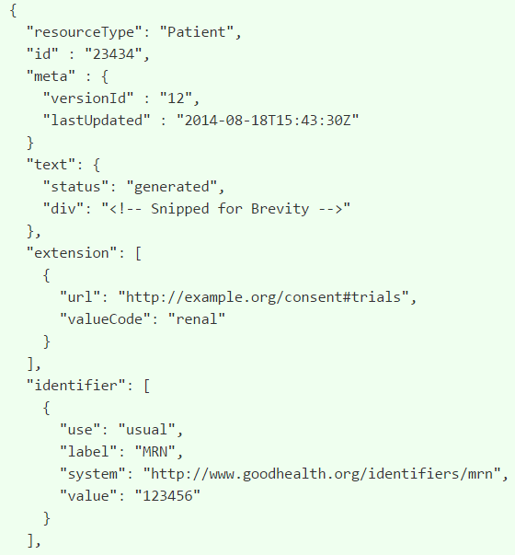

Slide 6
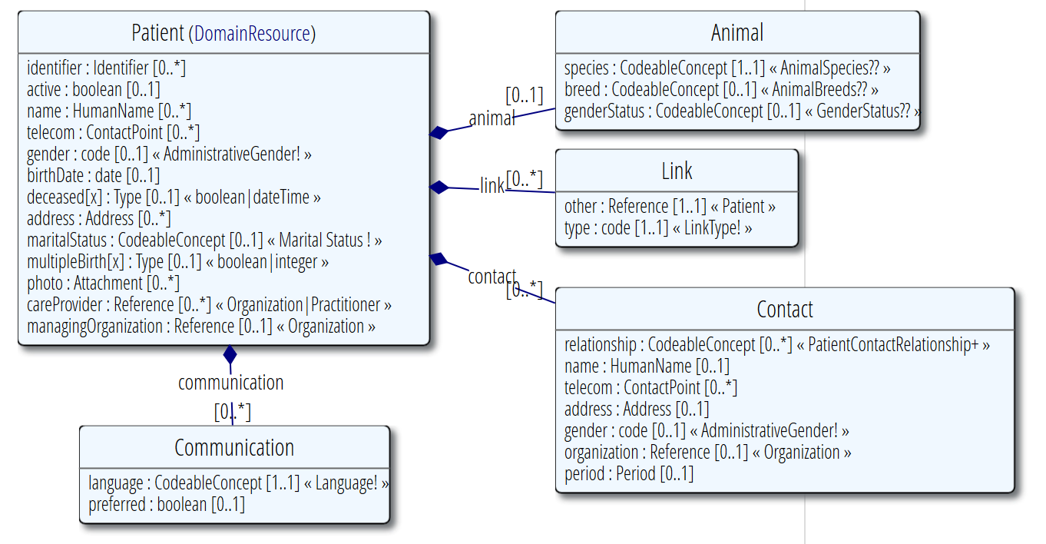
Patient Resource

Slide 7
Read a Resource
Given a URL, fetch the resource
HTTP GET – get me the contents of this resource
Specify the return type
Get an error or the resource
Example: http://fhir2.healthintersections.com.au/open/Patient/glossy
Use a RESTful client tester (demo)

Slide 8
Update a resource
Given a URL, update the contents to a new resource
HTTP PUT – store this resource here http://fhir2.healthintersections.com.au/open/Patient/glossy
Error or Success
Demo…

Slide 9
Create a resource
Ask the server to assign an identity to a resource
HTTP POST the resource to http://fhir2.healthintersections.com.au/open/Patient
Server responds with location

Slide 10
Delete a resource
Ask the server to remove the resource
HTTP Delete to the URL (e.g. http://fhir2.healthintersections.com.au/open/Patient/glossy
Read / Search (next) fails after this
Many healthcare records cannot be deleted
Server keeps a full version history / audit trail

Slide 11
Finding Resources
Find all the resources that meet a particular criteria
HTTP GET – on address http://fhir2.healthintersections.com.au/open/Patient
Search Parameters – different for each resource
Search parameters optional and extensible
Declared in the conformance statement

Slide 12
Dealing with Variability
The consensus process at HL7 cannot address business variability
Agreement is always incomplete
Structures:
Narrative in Resources
Extensions
Conformance Statements

Slide 13
Narrative in Resource
Every resource includes an XHTML section that describes it
A few resources are exempt
It’s not mandatory – but highly recommended
Clinical Safety Fall back (per CDA)
Allows general software to handle/display any resource
Allows information to travel

Slide 14
Extensibility
Every resource, element can have ‘extensions’
URL – reference the definition
Value
Anyone can add and publish extensions
Sliding scale of governance
Everyone can read and write all extensions
For handling local requirements

Slide 15
Example Extension
Eye Colour to patient resource:
Need to pick a URL
Need to choose a type
Have to declare and publish the extension (at the URL)
<Patient xmlns="http://hl7.org/fhir">
<extension
url="http://acme.org/fhir/patient#eyecolor">
<valueCode value="brown"/>
</extension>
…

Slide 16
Conformance
Terminology Use
Custom Codes, Value Sets, Mappings
Resource Use
Profiles and Logical Models, Data Dictionaries
Behaviour
Interaction support, Search Parameters, Operations
Published by Servers, Clients, Projects
“Implementation Guide”

Slide 17
Implementation Guides
“DAF” – Data Access Framework
“SDC” – Structured Data Capture
“US LAB” – Lab ordering & reporting
Privacy / Consent
Quality / Measure
Argonaut

Slide 18
Deployment
FHIR API is an external surface
Behind the surface is private
Common design options
De novo server based entirely on resources
Retrofit FHIR as a façade on existing system
Secondary repository
FHIR is entirely middleware
Many different technologies used

Slide 19
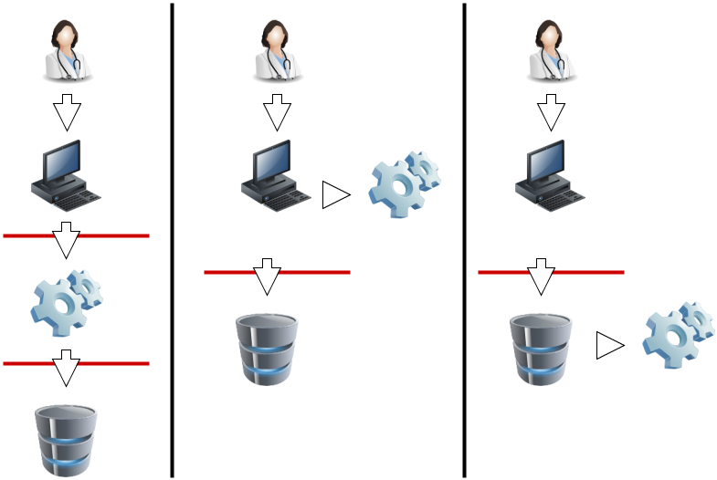
Deployment / Security

Slide 20
Deployment
No fixed design for an enterprise
Each is slightly different, though common themes
Typically
Multiple maintainers of patient registration
Legacy data & external integrations
Patient matching is an ongoing challenge

Slide 21
FHIR & Patient Matching
On the fly client mediating matching
Background reconciliation process

Slide 22
MPI Search
GET http://fhir2.healthintersections.com.au/open/Patient? _query=mpi& family=james& given=peter& gender=male
Ask the MPI to return possible matches

Slide 23
MPI Search Result
<Bundle xmlns="http://hl7.org/fhir">
<id value="70d41bcc-31fb-47ab-af18-67589b9650"/>
<meta>
<lastUpdated value="2016-02-28T14:04:40Z"/>
</meta>
<type value="searchset"/>
<total value="370"/>
<link>
....
</link>
...
</Bundle>

Slide 24
MPI Search Result
<entry>
<fullUrl value="…"/>
<resource>
<Patient xmlns="http://hl7.org/fhir">
<id value="11111"/>
....
</Patient>
</resource>
<search>
<extension
url="http://hl7.org/fhir/StructureDefinition/patient-mpi-match">
<valueCode value="possible"/>
</extension>
<mode value="match"/>
<score value="0.5"/>
</search>
</entry>

Slide 25
Where next?
“Distributed Patient Management”
An implementation guide that
describes best practices
defines internal and external services
provides for conformance expectations
standardizes patient matching approaches

Slide 26
Close - Questions

